Slide 1




Cybercrime:types,
causes and prevention
Course: Computer Science
Worked by: Bora Tollkuçi
Andja Cane
Admitted by:
Adelajda Shima
Tirana, 2024

Slide 2

Key points
Overview of cybercrime
Types of cybercrime
Impact of cybercrime
Cybercriminal Motivations
Cybersecurity Awareness and Education
Cybercrime Prevention Strategies

Slide 3


1
Overview of cybercrime

Slide 4

Cybercrime is the use of digital technologies such as computers and the internet to commit criminal activities. Malicious actors (often called “cyber criminals”) exploit computer hardware, software and network vulnerabilities.

Slide 5

2
About Us
Types of cybercrime

Slide 6

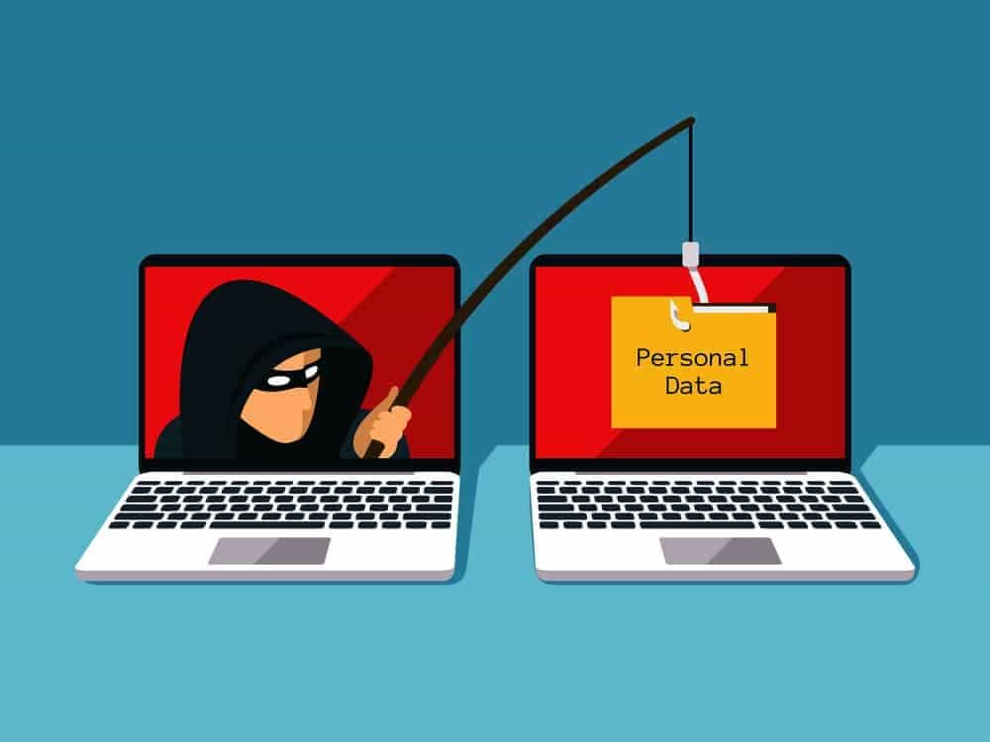


Hacking
Phishing
Identity theft
Malware

Slide 7

3
The Impact of Cybercrime

Slide 8

Cybercrime can affect individuals, businesses, and society in a variety of ways:
Financial losses
Personal effects
Both individuals and businesses can suffer economic damage due to cybercrime.
After a cyberattack, individuals may need to spend time protecting themselves and preventing further damage
Business disruption
Public safety
This can lead to website downtime, loss of customers and profits, and reputational damage.
Cyber criminals may target critical infrastructure such as power grids or manufacturing plants.

Slide 9


Cybercriminal Motivations
4

Slide 10
Cybercriminals are motivated by various factors that drive them to engage in illicit activities in the digital realm.
Financial Gain
State-Sponsored
Cyberattacks
Intellectual
Challenge and Curiosity
Political or Ideological Reasons
Monetary Gain through Cybercrime Services

Slide 11

5
Cybersecurity Awareness and Education
Our Projects
Elaborate on what you want to discuss.

Slide 12

Here are key elements of a cybersecurity awareness and education program
Regular Employee Training
New Employee Orientation
Simulated Phishing Exercises
Strong
Password Policies
Mobile
Device
Security
Conduct ongoing cybersecurity training sessions for all employees to keep them informed about the latest threats, best practices, and company policies.
Include cybersecurity awareness training as part of the onboarding process for new hires.
Conduct simulated phishing exercises to test employees' ability to recognize phishing attempts and provide immediate feedback on their actions.
Establish and enforce strong password policies, including guidelines for creating and managing secure passwords.
Provide guidance on securing mobile devices, including the use of passcodes, encryption, and secure Wi-Fi connections.

Slide 13

6
Cybercrime Prevention Strategies

Slide 14
Strong Passwords
Use complex passwords that include a mix of uppercase and lowercase letters, numbers, and special characters.
Update Software Regularly
Regularly update operating systems, software applications, and antivirus programs to patch known vulnerabilities.
Use a Secure Wi-Fi Connection
Secure your home Wi-Fi network with a strong password.

Slide 15
References
https://cybertalents.com/blog/what-is-cyber-crime-types-examples-and-prevention
https://www.eccouncil.org/cybersecurity-exchange/computer-forensics/cybercrime-types-prevention-digital-forensics/

Slide 16
Thank you!

